Slide 1
MSc Dissertation Presentation
Using Microsoft Quantum Development Kit for binary classification of MNIST Dataset
Jayprakash Asolkar
MSc in Computer Science – Intelligent Systems
Date 20/08/20

Slide 2
Motivation
Classical Machine Learning solutions are Resource Intensive
Accuracy and Efficiency of classical ML algorithms depends on large amount of training data
Increasing training data requires exponential growth of processing power and storage
Quantum Computation promises to provide exponential speedups
Quantum Information Processing techniques can inherently compress classical data
Few of the existing quantum algorithms are theoretically superior to best known classical counterparts in terms of execution speed.
Availability of multiple frameworks for experimental verification of Quantum Superiority
Lack of practical implementations of available quantum algorithms over real world dataset
Newly available frameworks provide opportunity to execute quantum applications on Quantum Simulators/Hardware

Slide 3


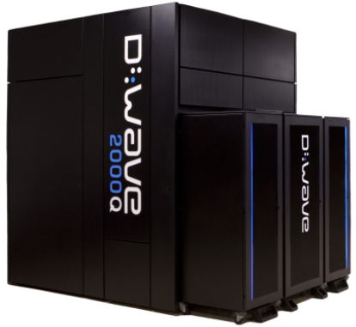





Motivation
Companies investing in Quantum Hardware and Software

Slide 4
Research Objectives
RESEARCH QUESTION: Developing a hybrid Quantum Machine Learning (QML) application to perform binary classification of MNIST images using Microsoft Quantum Development Kit to help my reader understand the process of near term quantum application development.
Learning about Quantum Computation and Quantum Information Processing
Understanding the State of the Art of Quantum Machine Learning for data classification
Evaluation of Data Classification library in Microsoft Quantum Development Kit on real world dataset
Identifying useful resources and current challenges for real world application development using Microsoft QDK

Slide 5
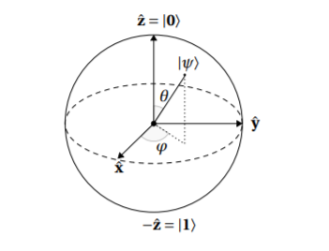
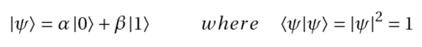
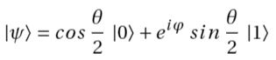
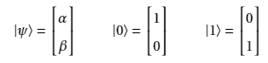
Background Research
Quantum Bit or Qubit
Qubit – Fundamental unit of quantum computation and Quantum Information
Unlike Classical Bits, state of Qubit is a unit vector in a 2-dimensional complex vector space called Hilbert Space.
State Vector:
State in terms of angles:
State Vectors:
Multi-Qubit System for 2 Qubits:
Fig. Bloch Sphere

Slide 6
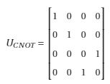
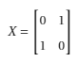
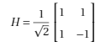
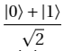
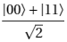
Background Research
Evolution of Quantum States
Quantum Gates (Unitary Matrices)
Quantum Equal Superposition:
Quantum Entanglement:
Quantum Measurement: Quantum State measurement collapses the superposition state to one of the basis states
Fig. Hilbert Space

Slide 7
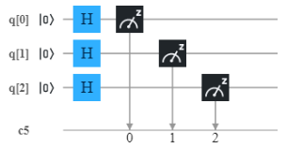
Background Research
Quantum Circuits and Quantum Algorithms
Quantum algorithms = combination of circuits
Quantum Parallelism and Superposition provide advantages over classical computers
Shor’s algorithm for finding prime factors of a number, Grover’s algorithm for searching in unsorted database are some of the famous quantum algorithms
Many theoretical quantum implementations of the classical machine learning algorithms are proposed
Most algorithms are not readily testable on real quantum hardware due to higher resource requirements
Fig. Example Quantum Circuit
Random Number Generator

Slide 8
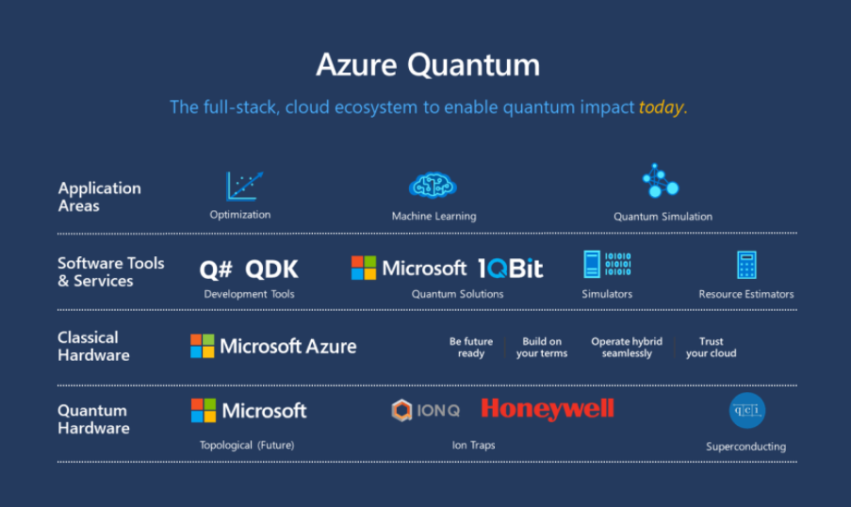
Why Microsoft QDK?
Hardware Independent
Open Source Libraries and training material
Q# Programming Language - Inspired from classical high level languages
Upcoming cloud access through Azure Quantum
Development in progress for solutions of real-world problems
Quantum Simulators for execution on classical computer
Libraries for Quantum Chemistry, Machine Learning applications

Slide 9
Circuit-Centric Quantum Classifier
Schuld, M., Bocharov, A., Svore, K. & Wiebe, N. Circuit-centric quantum classifiers. arXiv preprint arXiv:1804.00633 (2018)
Problems with Near-Term Quantum hardware
Less number of Qubits
Decoherence
Error-Prone (Noise)
Solutions
Shallow Depth of Circuits
Perform short bursts of measurements on Quantum Computer
Divide the data in chunks for processing
Hybrid Computation with Quantum Subroutine (Variational Quantum EigenSolver)
Cost Function Optimization using Classical Computer

Slide 10
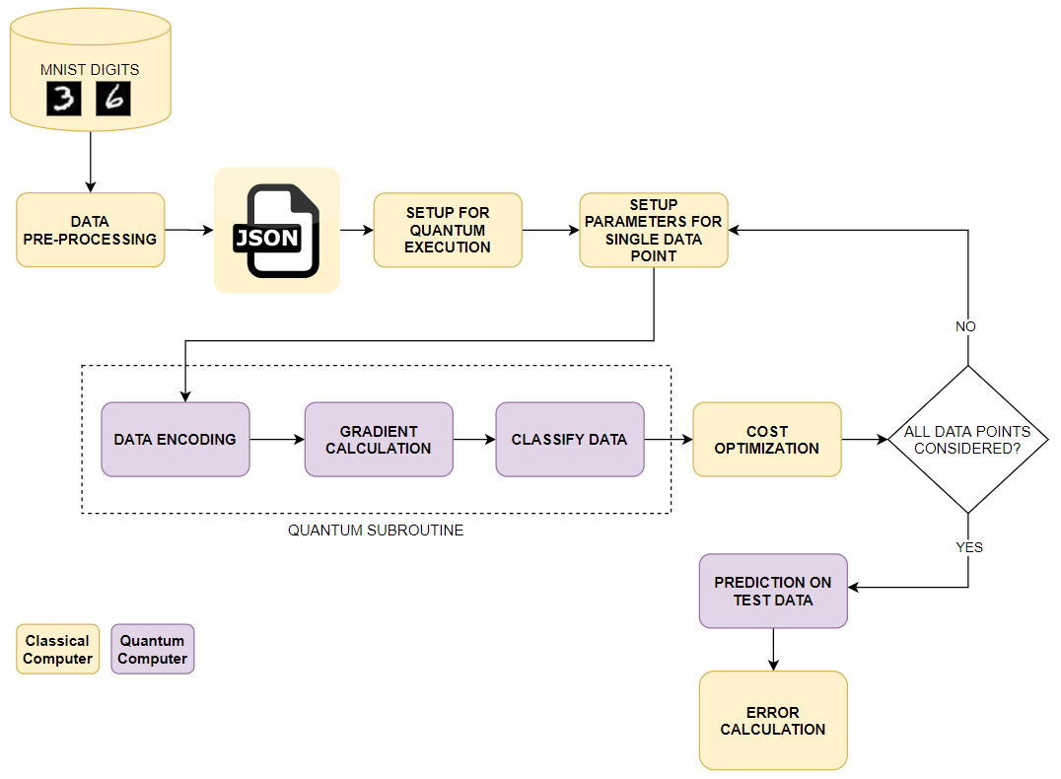
Implementation - Solution Architecture

Slide 11
Data Processing and Setup
Each MNIST image is of dimensions 28 x 28 pixels, which corresponds to 784 features per image
Experiments were carried out with 2000 images of digits 3 and 6 for training and a separate dataset of 100 images for validation of the model
To reduce the possible exponential processing time on quantum simulator, it was necessary to reduce number of features
Feature reduction was carried out classically using Principal Component Analysis (PCA) algorithm using SKLEARN’s python library
Images are converted to vectors in JSON format by selecting 10 and 30 principal components
Classical computer reads the JSON file to extract training features and labels and feeds this data to the quantum subroutine
The data is fed to the Quantum Computer in batches for incremental learning.
No. | PIXEL 1 | PIXEL 2 | PIXEL 3 | PIXEL 4 | LABEL
1 | 10 | 55 | 41 | 94 | 1
2 | 13 | 25 | 32 | 12 | 0
3 | … | … | … | … | 0
4 | … | … | … | … | 1
5 | … | … | … | … | 1
6 | … | … | … | … | 1
7 | … | … | … | … | 0
Table: Sample Data with 4 principal components for 7 images

Slide 12
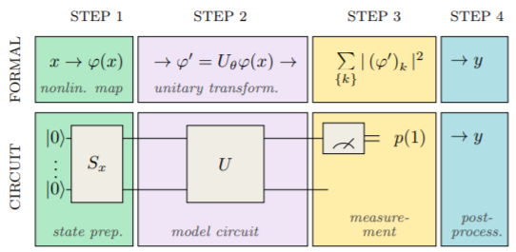
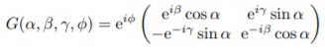
STEP 1 - Data Encoding
This process converts classical information stored in bits to quantum information stored in qubits
Basic Encoding: 1111 →
Amplitude Encoding
Information stored in amplitudes of basis states
For eg: Consider first image of 4 pixels, each with possible values from 0 to 255
Sum of Pixel Values for image: 15 + 44 + 134 + 207 = 400
Divide each pixel value by the sum: 0.0375, 0.11, 0.335, 0.5175. These values correspond to the squares of the amplitudes of basis states.
This way values of N pixels for one image can be represented by Log₂N qubits
Gate for arbitrary state preparation:
Fig. Steps in Quantum Processing
arXiv preprint arXiv:1804.00633 (2018)
No. | PIXEL 1 | PIXEL 2 | PIXEL 3 | PIXEL 4 | Label
1 | 15 | 44 | 134 | 207 | 1
2 | 54 | 25 | 183 | 190 | 1
3 | 114 | 230 | 1 | 89 | 0
4 | 87 | 5 | 187 | 254 | 1
Table: 4 Images of 4 pixels each

Slide 13
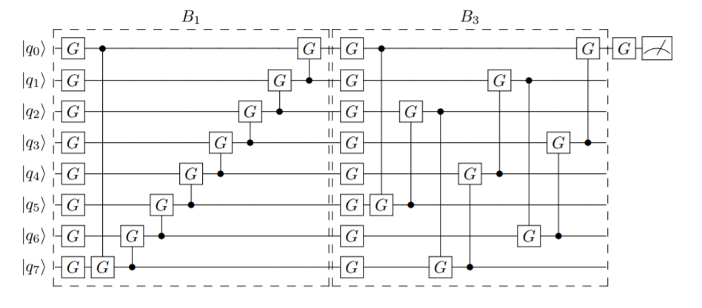
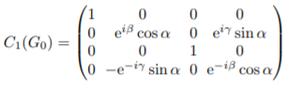

STEP 2 - Quantum Gradient Calculation
Fig. Quantum gate acting on 2 qubits
Fig. Layers of quantum gates with controllable parameters to entangle input qubits (QAOA)
Fig. Analogy: Radio With Knobs to control frequency
CONTROL PARAMETERS:
Number of layers
Number of qubits acted on by given layer
Rotation Axis, Range of connection between qubits
Hyperparameters – Learning Rate, Number of Epochs, Batch Size, Number of measurements

Slide 14
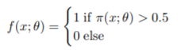
STEP 3,4 – Measurement & Post Processing
Fig. Layers of quantum gates with controllable parameters to entangle input qubits
First qubit is measured to get the predicted label
Number of measurements (shots) can be altered for determining the probability more precisely
Adding learnable bias to produce continuous output
Dropouts of random qubits for reducing overfitting
Prediction Function: where

Slide 15
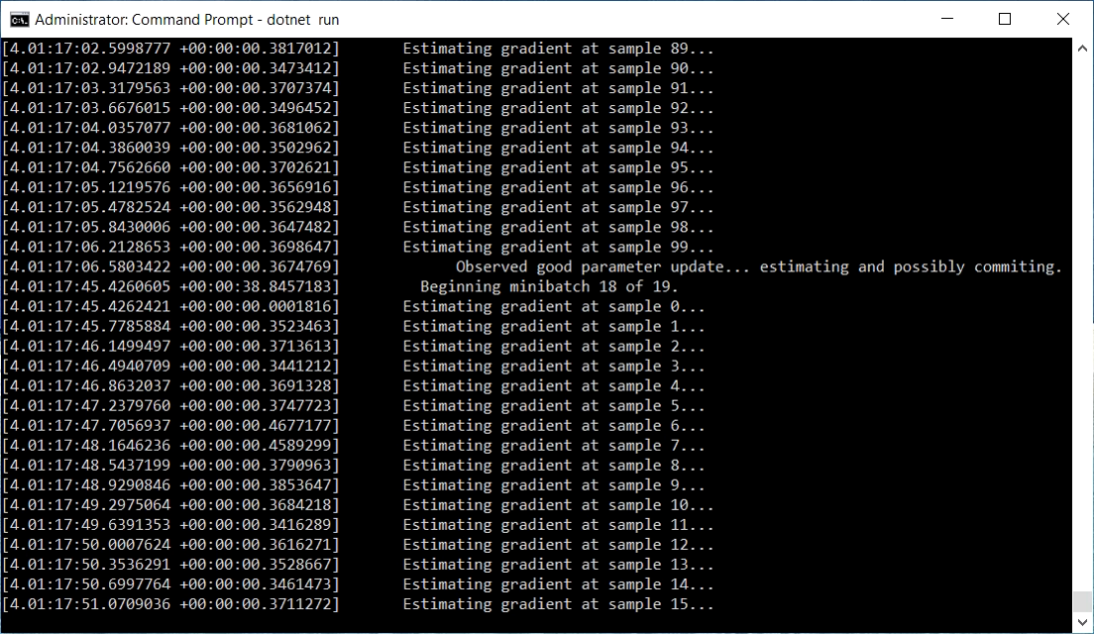
Execution

Slide 16
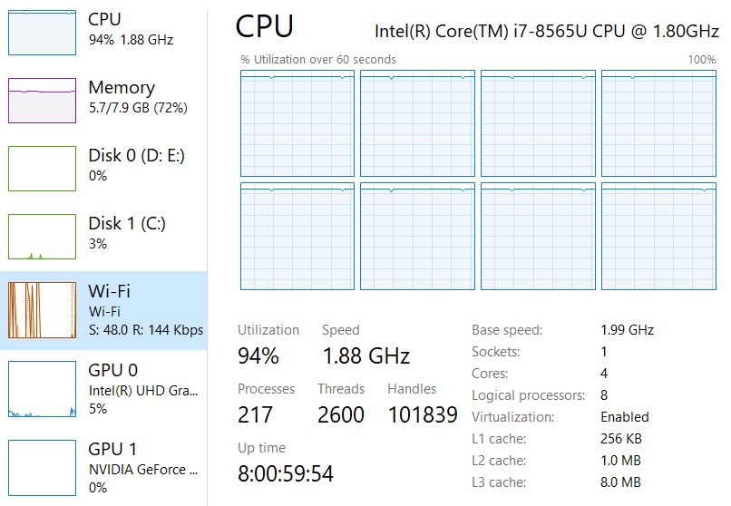
Computational Resources
For Quantum Simulator

Slide 17
Results
Number of Features | Number of Images | Layers | Learning Rate/Epochs | Result | Execution Time | Accuracy
2 | Train – 100 Test – 20 | 2 LocalRotationsLayer 1 CyclicEntanglingLayer 1 PartialRotationsLayer | 0.4/4 | Passed | 2 hours | 43%
10 | Train – 195 Test – 28 | 2 LocalRotationsLayer 1 CyclicEntanglingLayer 1 PartialRotationsLayer | 0.4/4 | Passed | 2 Hours | 60%
784 | Train – 195 Test – 28 | 1 LocalRotationsLayer | 0.4/4 | Failed IDE Crash | 14 Days | NA
30 | Train – 2000 Test - 200 | 2 LocalRotationsLayer 1 PartialRotationsLayer | 0.4/2 | Passed | 6 Days | 55%
30 | Train – 2000 Test – 200 | 2 LocalRotationsLayer 1 CyclicEntanglingLayer | 0.4/2 | NA | In Progress | NA

Slide 18
Discussion
Longer execution time with Quantum Simulators
Accuracy of Classical SVM algorithm (python SKLEARN library) is above 95% for the same dataset
Execution time of Classical SVM algorithm is only a few minutes
CPU and Memory Utilization of the Quantum Simulator is higher
Experiments for Multi-Class classification will take exponential execution time
Unavailability of results on real quantum computer restrict us to make any claim about the performance superiority

Slide 19
Challenges
No access to Quantum Hardware (Azure Quantum)
Availability of only a single classical computer for Quantum Simulation
Limited API Documentation
Slow Performance of Microsoft QDK machine learning library on quantum simulator

Slide 20
Future Work
Quantum Subroutine execution on real quantum hardware
Performing experiments on variety of datasets
Comparison of multiple Quantum Development Frameworks such as IBM’s QISKIT, Google’s CIRQ, Amazon’s BRAKET
Comparing the performance of other QML algorithms
Performance Improvements

Slide 21
Thank You

